Slide 1
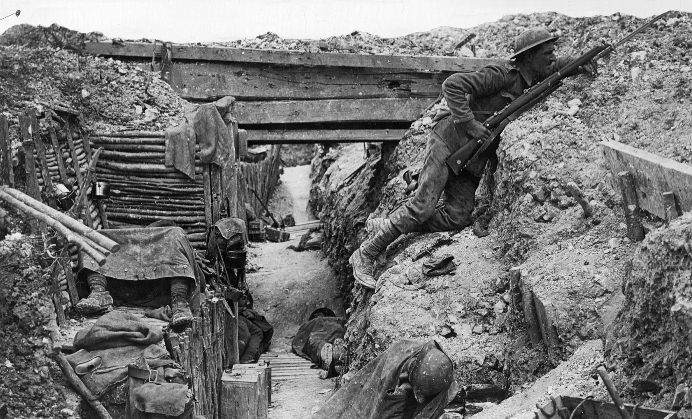






1914-1918
Chapter 21
WORLD WAR I
world war i
Strand Two & Three: The History of the World
@MsDoorley

Slide 2
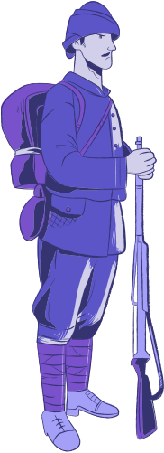
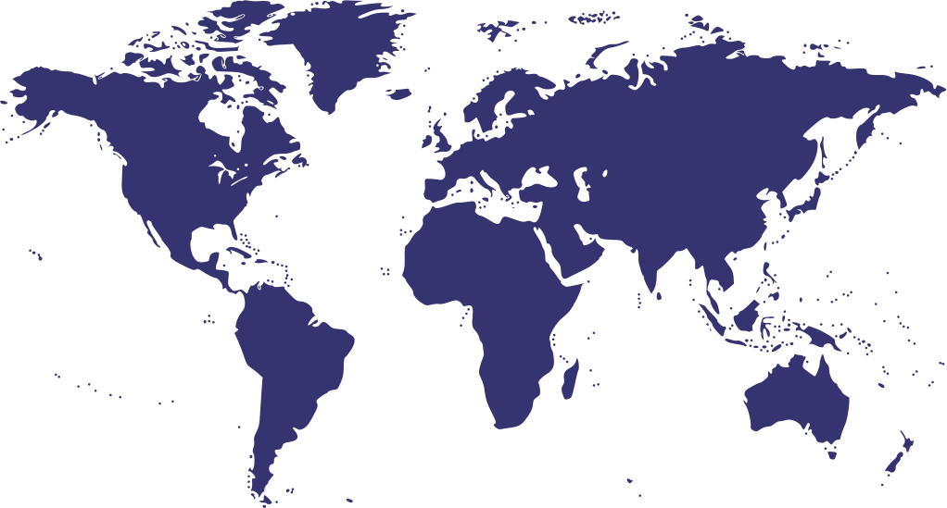
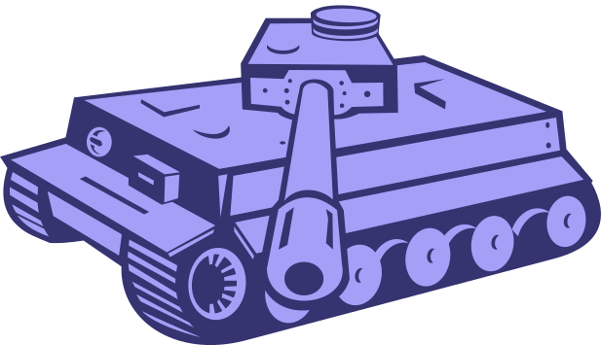

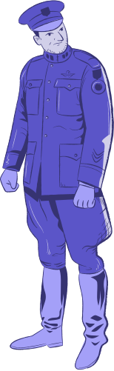
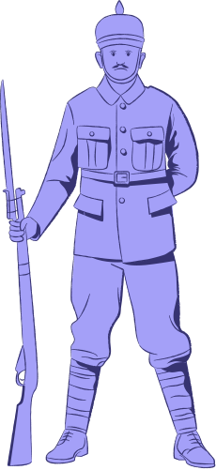
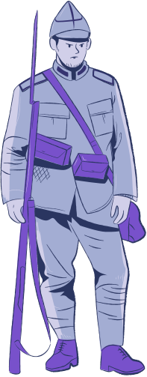
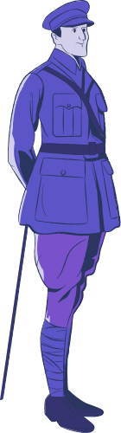






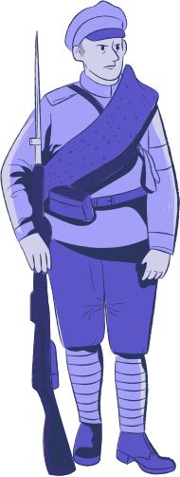
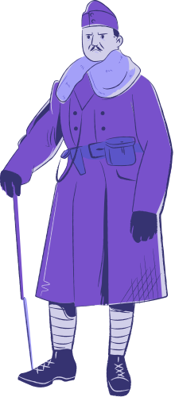
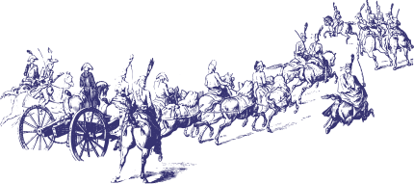
Chapter 21
WORLD WAR I
The allies of Austria-Hungary and Serbia declare war on each other, throwing Europe into the "Great War".
The Battle of the Somme: the deadliest battle of the war with almost 1 million dead.
War comes to an end on the 11th November: Germany surrenders to the Entente.
June
1914
August
1914
1915
1916
1917
1918
1919
Strand Two & Three: The History of the World
Chapter Twenty-One: World War I
The assassination of Archduke Franz Ferdinand and his wife leads to war between Austria-Hungary and Serbia.
The first use of chemical attacks in war. Italy enters the war on the side of the Entente.
@MsDoorley
The US enters the war: Russia pulls out from the war due to the Bolshevik Revolution.
The Treaty of Versailles signed at the Paris Peace Conference

Slide 3
Learning Outcomes
3.4 DISCUSS the general causes and course of World War I or World War II and the immediate and long- term impact of the war on people and nations.
1.2 CONSIDER contentious or controversial issues in history from more than one perspective and discuss the historical roots of a contentious or controversial issue or theme in the contemporary world.
1.9 DEMONSTRATE awareness of the significance of the history of Ireland and of Europe and the wider world across various dimensions, including political, social, economic, religious, cultural and scientific dimensions.
Strand Two & Three: The History of the World
Chapter Twenty-One: World War I
@MsDoorley

Slide 4
Introduction
The twentieth century saw extraordinary advances in science and technology that would transform people’s lives. However, it was without comparison in human history for the sheer scale of destruction and misery that people inflicted upon each other.
Over the four years of World War I, 18 million people died and there were profound changes in governments, societies and technology. The war’s aftermath shaped a world which would see even more devasting conflicts.
Strand Two & Three: The History of the World
Chapter Twenty-One: World War I
@MsDoorley

Slide 5
1914-1918
Chapter 21
21.1: THE CAUSES OF WORLD WAR I
21.1: the causes of world war i
Strand Two & Three: The History of the World
@MsDoorley

Slide 6
Europe falls apart
In the years before 1914, Europe was dominated by empires that were competing for power and territory. A number of issues were driving European countries apart:
  Disagreements over colonies in Africa and Asia
  Military arms races, especially between Germany and Britain over their naval fleets
  Competition between Austria and Russia for influence in the Balkans (south-east Europe) as the Ottoman Empire slowly collapsed and new states (such as Serbia) emerged.
These issues saw the creation of a system of alliances between states. An alliance is an agreement between states to aid each other in wartime. Following the death of Queen Victoria in 1901 was the last time European leaders (mostly made up of the Queen’s grandchildren) were seen together peacefully.
On the 28th June 1914 the heir to the Austro-Hungarian Empire, the Archduke Franz Ferdinand, was assassinated in Sarajevo (the capital of Bosnia).
Strand Two & Three: The History of the World
Chapter Twenty-One: World War I
@MsDoorley

Slide 7
The "Great War" Begins
The Austrians blamed the Serbian government for his death. The July Crisis would follow, with Austria and their ally Germany making demands and ultimatums on Serbia with no budge on the latter's side. On the 28th July 1914, Austria-Hungary sent their declaration of war on Serbia, marking the beginning of the First World War, or as it was known at the time, the "Great War".
Russia, an ally of Serbia, declared war on Austria in response. Germany, who had encouraged its Austrian ally to take a hard line on Serbia, declared war on Russia. France, an ally of Russia, went to war with Germany. When Germany’s army invaded Belgium to get to France, Britain (which had promised to protect Belgium) declared war on Germany.
The Entente Powers | The Central Powers
Britain (and Ireland) | Germany
France | The Austro-Hungarian Empire (Habsburg Empire)
Russian Empire (until October 1917) | The Ottoman Empire
Italy (from 1915)
The United States (from 1917)
Strand Two & Three: The History of the World
Chapter Twenty-One: World War I
@MsDoorley

Slide 8
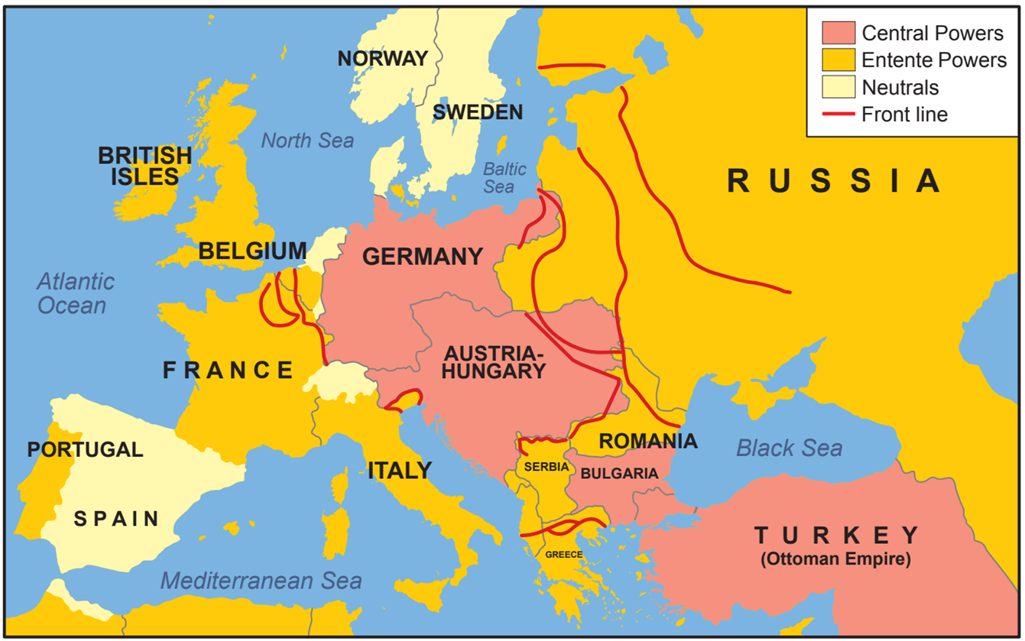
Strand Two & Three: The History of the World
Chapter Twenty-One: World War I
Diagram taken from Artefact, 2nd Edition by Eimear Jenkinson and Gregg O'Neill (educate.ie)
@MsDoorley

Slide 9
Checkpoint pg. 287 (Artefact, 2nd Edition)
  Why were there tensions between European states in the years before World War I?
  What is an alliance?
  What event sparked the outbreak of war in 1914?
  Which countries were on either side in the conflict?
Strand Two & Three: The History of the World
Chapter Twenty-One: World War I
@MsDoorley

Slide 10
Checkpoint pg. 287 (Artefact, 2nd Edition)
  Why were there tensions between European states in the years before World War I?
    Disagreements over colonies in Africa and Asia
    Military arms races, especially between Germany and Britain over their naval fleets
    Competition between Austria and Russia for influence in the Balkans (south-east Europe) as the Ottoman Empire slowly collapsed and new states (such as Serbia) emerged.
  What is an alliance?
    An alliance is an agreement between states to aid each other in wartime.
  What event sparked the outbreak of war in 1914?
    On the 28th June 1914 the heir to the Austro-Hungarian Empire, the Archduke Franz Ferdinand, was assassinated in Sarajevo (the capital of Bosnia).
  Which countries were on either side in the conflict?
Strand Two & Three: The History of the World
Chapter Twenty-One: World War I
The Entente Powers | The Central Powers
Britain (and Ireland) | Germany
France | The Austro-Hungarian Empire (Habsburg Empire)
Russian Empire (until October 1917) | The Ottoman Empire
Italy (from 1915)
The United States (from 1917)
@MsDoorley

Slide 11
1914-1918
Chapter 21
21.1: LIFE DURING WORLD WAR I
21.1: life during world war i
Strand Two & Three: The History of the World
@MsDoorley

Slide 12
Life in the Trenches
Both sides had expected the war to be over within months; British soldiers going as far to tell their families that they would be home by Christmas. However, the war quickly developed into a stalemate (neither side could win) that would drag on for FOUR YEARS. The Germans, who had almost defeated the French in the first few weeks had to split their forces between the Eastern Front (Russia) and the Western Front (France/Britain). While the Germans couldn’t defeat their Eastern enemies, neither could the French and British drive the German army out of northern France. Along the Western Front, soldiers dug networks of deep trenches to protect themselves from enemy fire.
The strip of land between the opposing armies was called no man’s land. The ground here quickly became a deep, sticky and dangerous mud ground which lasted for the entire war. Trenches and shell craters were often full of foul water. To take the enemy trenches, soldiers had to climb out of their trenches (go ‘over the top’) and march across no man’s land. They were met by barbed wire, machine-gun fire and shelling. This made World War I battles incredibly bloody. For example, in 1916 there was 1.1 million people killed over five months at the Battle of the Somme alone.
Strand Two & Three: The History of the World
Chapter Twenty-One: World War I
@MsDoorley

Slide 13
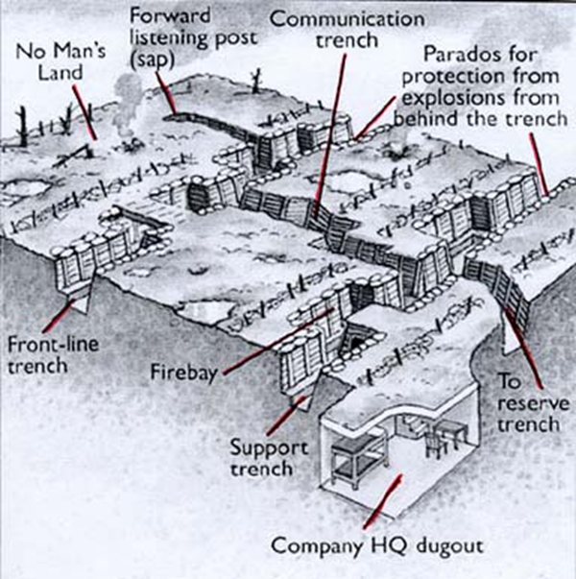
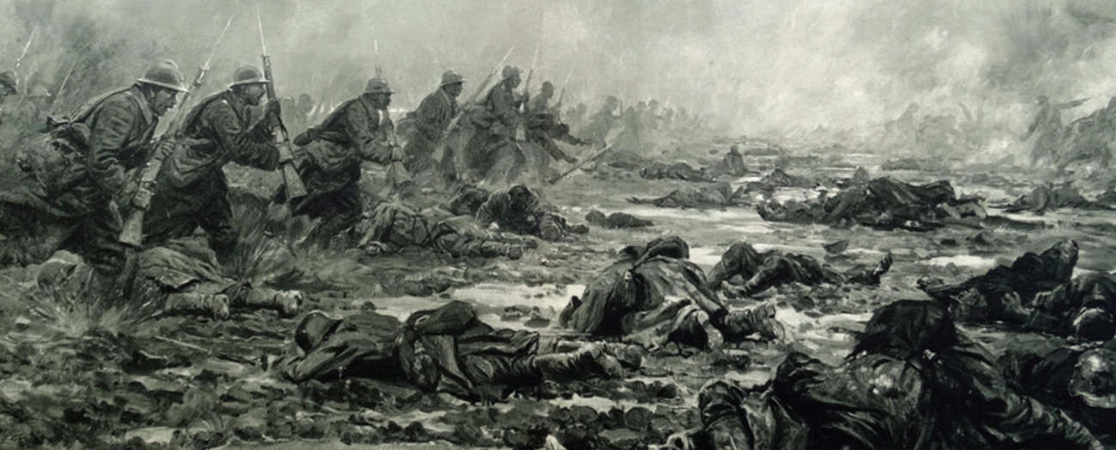
Strand Two & Three: The History of the World
Chapter Twenty-One: World War I
Diagram taken from Artefact, 2nd Edition by Eimear Jenkinson and Gregg O'Neill (educate.ie)
@MsDoorley

Slide 14
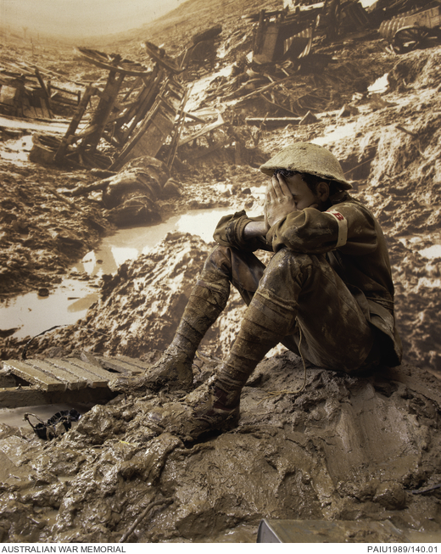
A New Era in Warfare
World War I also saw the introduction of new military technology, including the first use of aeroplanes for reconnaissance, aerial combat and bombing. German submarines (U-boats) attacked any ships (military or civilian) in enemy waters. The British invented the tank to try to break the stalemate on the Western Front. Mines and grenades were widely used.
World War I saw the first use of chemical weapons: chlorine, mustard and phosgene gas. Warfare had been transformed; never before could so many be killed, at a distance and in so many ways. Sadly, the generals were slow to adjust their tactics to this new reality – at the cost of their men.
Within six months of fighting, medics observed a set of symptoms among the trenches that they called ‘shell shock’. Today, it is known as Post-Traumatic Stress Disorder (PTSD). Symptoms included: Extreme anxiety, Tremors, Confusion, Memory loss, Nightmares and Sudden sight or hearing loss.
Strand Two & Three: The History of the World
Chapter Twenty-One: World War I
Diagram taken from Artefact, 2nd Edition by Eimear Jenkinson and Gregg O'Neill (educate.ie)
@MsDoorley

Slide 15
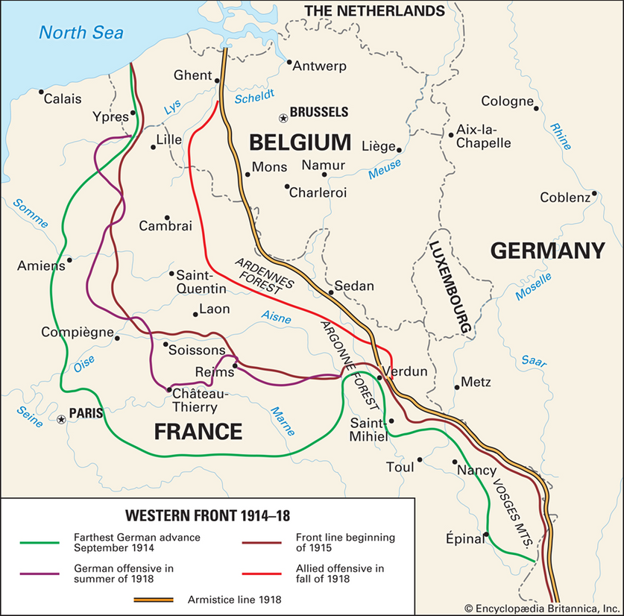
The Battle of the Somme
The Battle of the Somme (1st July 1916 - 18th November 1916) took place in France, near the Somme River – hense the name of the battle. It was a battle fought by the armies of:
  The British Empire (Military commander: Douglas Haig)
  The French Third Republic (Military commander: Ferdinand Foch)
  The German Empire (Military commander: Max von Gallwitz and Fritz von Bellow)
It took 30 seconds for the first soldier to die. The aim of the attack was to break through German lines and defeat the German army. It was also hoped that the attack, started by the British, would allow the French Army to strike back on its own front.
General Haig was highly criticized for so long, because he carried on with the battle when 20,000 people had already died on the first day of the battle.
Many historians credit the win to the British and French forces. However, others believe it was a draw because of the large causalities suffered.
Strand Two & Three: The History of the World
Chapter Twenty-One: World War I
@MsDoorley

Slide 16
The Battle of the Somme
They used: Machine guns, Rifles, Grenades, Flamethrowers and Poisonous gasses. Artillery was used as a destructive weapon that fired shells at long distance, meaning there was little risk of hitting your own troops.
This battle also saw the first major use of chemical weapons in warfare. Chlorine Gas was first used 22 April 1915. A greenish-yellow cloud that smelled like bleach. Killed soldiers by asphyxiation. Phosgene gas was six times more deadly than chlorine gas. Responsible for 85% of chemical weapons fatalities during WWI. (slow acting poison). Mustard gas caused severe blistering on it’s victims. Caused blindness (slow acting poison)
The Battle of the Somme symbolised the “horrors of warfare”. The French lost 200,000 men, the British suffered 420,000 casualties while the Germans lost 500,000. A total of over one million soldiers lost their lives, out of the over three million soldiers who fought.
The first day was a complete disaster for the British: they suffered 20,000 troop fatalities and a further 40,000 troops were either taken captured or so badly injured that they could not fight the next day. General Haig was highly criticized for so long, because he carried on with the battle when they had already suffered huge losses on the first day of the battle.
Many historians credit the win to the British and French forces. However, others believe it was a draw because of the large causalities suffered.
Strand Two & Three: The History of the World
Chapter Twenty-One: World War I
Footage from the Battle of the Somme
@MsDoorley

Slide 17
The End of the War
The bloody conflict dragged on for over four years. Attempts by the Entente Powers to break the stalemate by attacking in 1915 failed during the Battle of Gallipoli. The Russian government was overthrown in October 1917 by the Bolsheviks (communists) led by Vladimir Lenin – ending Russian involvement in the war. However, the US entered the war on the Entente’s side in 1917. The arrival of one million American troops eventually turned the tide in their favour. Germany and its allies surrendered in November 1918.
Strand Two & Three: The History of the World
Chapter Twenty-One: World War I
@MsDoorley

Slide 18
Checkpoint pg. 289 (Artefact, 2nd Edition)
  Why was there a stalemate during much of World War I?
  What were trenches and no man’s land in World War I?
  How were battles fought on the Western Front?
  Why did these battles have so many casualties?
  What new technology was introduced to warfare during World War I?
  How did the war end?
Strand Two & Three: The History of the World
Chapter Twenty-One: World War I
@MsDoorley

Slide 19
1914-1918
Chapter 21
21.3: THE PARIS PEACE CONFERENCE
21.3: the paris peace conference
Strand Two & Three: The History of the World
@MsDoorley

Slide 20
"To the victors, the spoils..."
The Entente Powers dictated the terms of the peace treaty to Germany and its allies. They met for a ‘peace’ conference at Versailles, outside Paris, throughout 1919. There were three main leaders (the Big Three):
  Woodrow Wilson (US President)
  Georges Clemenceau (French Prime Minister)
  David Lloyd George (British Prime Minister)
Each of the three leaders wanted different things.
  Wilson wanted a just peace to prevent future wars. He outlined his views in his ‘Fourteen Points’ speech when the US entered the war. He sought to reduce the size of armies to preserve the peace. He also believed in self-determination (the right of a people or nation sharing a common language and culture to govern themselves independently). He wanted a new organisation, the League of Nations, set up to keep peace between nations.
  Clemenceau blamed the Germans for starting the war and therefore wanted to punish Germany. France had lost 1.4 million men in the war and suffered billions in damages. They demanded compensation. Clemenceau was also determined to secure France against future German attacks and to prevent Germany ever being a threat again.
  Lloyd George also wanted Germany punished to appease people at home in Britain. He saw the peace treaty as an opportunity to expand the British empire and boost the British economy, both at the expense of Germany.
Strand Two & Three: The History of the World
Chapter Twenty-One: World War I
@MsDoorley

Slide 21
The Treaty of Versailles
After six months of negotiations, the Treaty of Versailles was agreed in June 1919. The German representatives were not given a chance to seek any changes to the text. They were told to agree or else there would be a return to war.
  The War Guilt Clause placed blame solely on Germany for starting the war.
  Germany would pay £6.6 billion (€350 billion in today’s money) in reparations (compensation payments paid by the loser to the victors after a war) to Britain, France and other countries. The debt was finally cleared in 2010.
  Germany surrendered all its colonies in Africa and Asia to Britain and Japan.
  Germany lost territory in Europe to France, Denmark and Poland.
  The German armed forces were reduced to 100,000 men and only six naval ships and they were banned from having an air force, tanks or submarines.
  Germany and Austria were forbidden to unite.
  To protect France’s security, the Rhineland (the border area between the two countries) became a demilitarised zone (Germany was banned from putting any troops in the Rhineland).
  The League of Nations was set up.
Strand Two & Three: The History of the World
Chapter Twenty-One: World War I
@MsDoorley

Slide 22
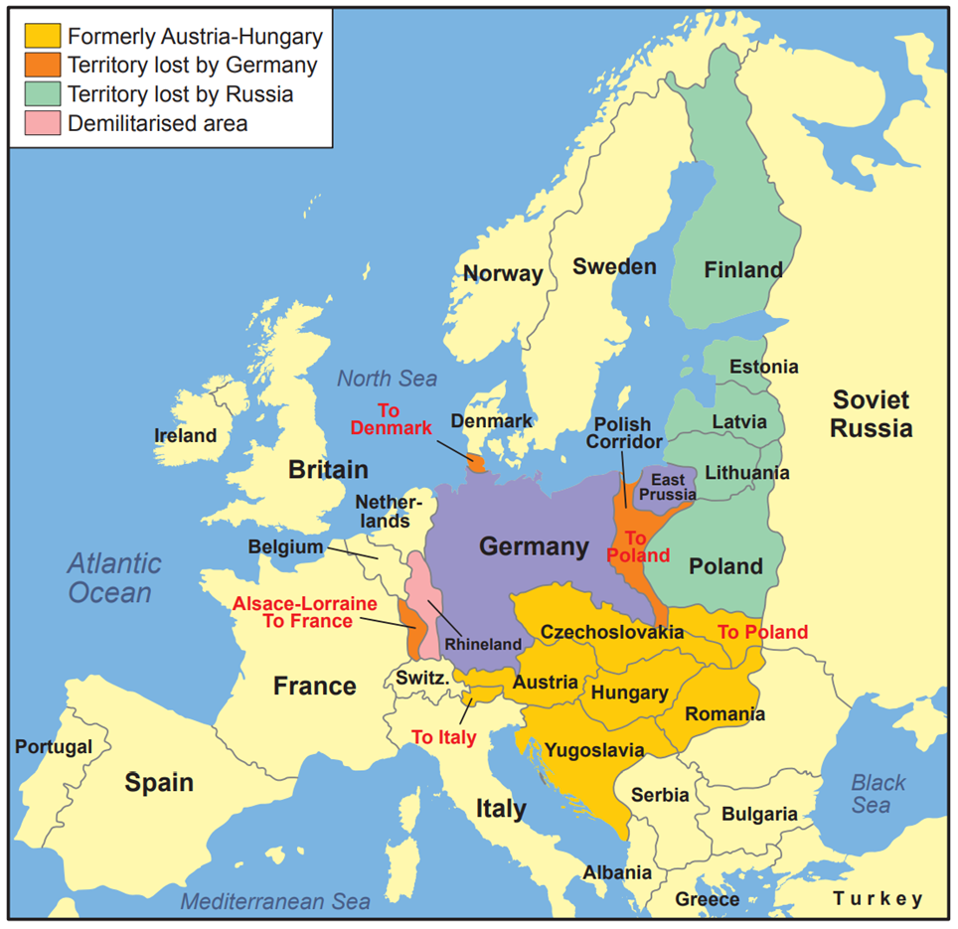
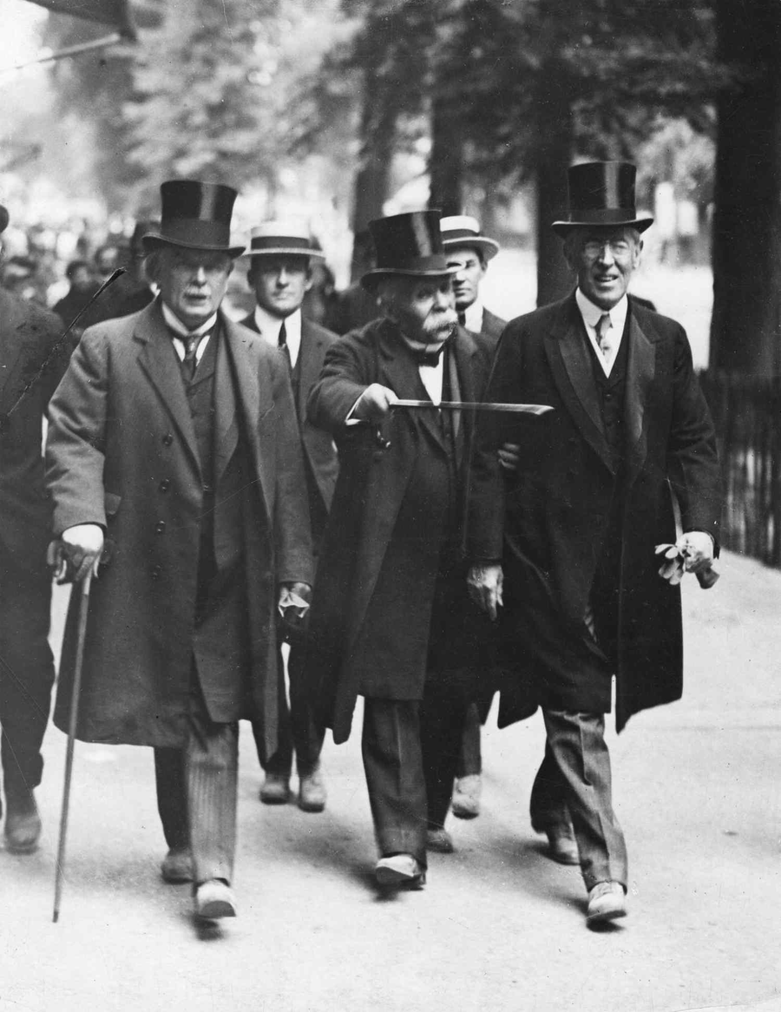
Strand Two & Three: The History of the World
Chapter Twenty-One: World War I
Diagram taken from Artefact, 2nd Edition by Eimear Jenkinson and Gregg O'Neill (educate.ie)
@MsDoorley

Slide 23
Checkpoint pg. 290 (Artefact, 2nd Edition)
  Who were the Big Three at the Paris Peace Conference?
  What did each of them want from the negotiations?
  What was the War Guilt Clause?
  What were reparations?
  What territories did Germany lose after World War I?
  What happened to the German armed forces?
  How do you think the German people felt about the Treaty of Versailles?
Strand Two & Three: The History of the World
Chapter Twenty-One: World War I
@MsDoorley

Slide 24
1914-1918
Chapter 21
21.4: THE CONSEQUENCES OF WORLD WAR I
21.4: the consequences of world war i
Strand Two & Three: The History of the World
@MsDoorley

Slide 25
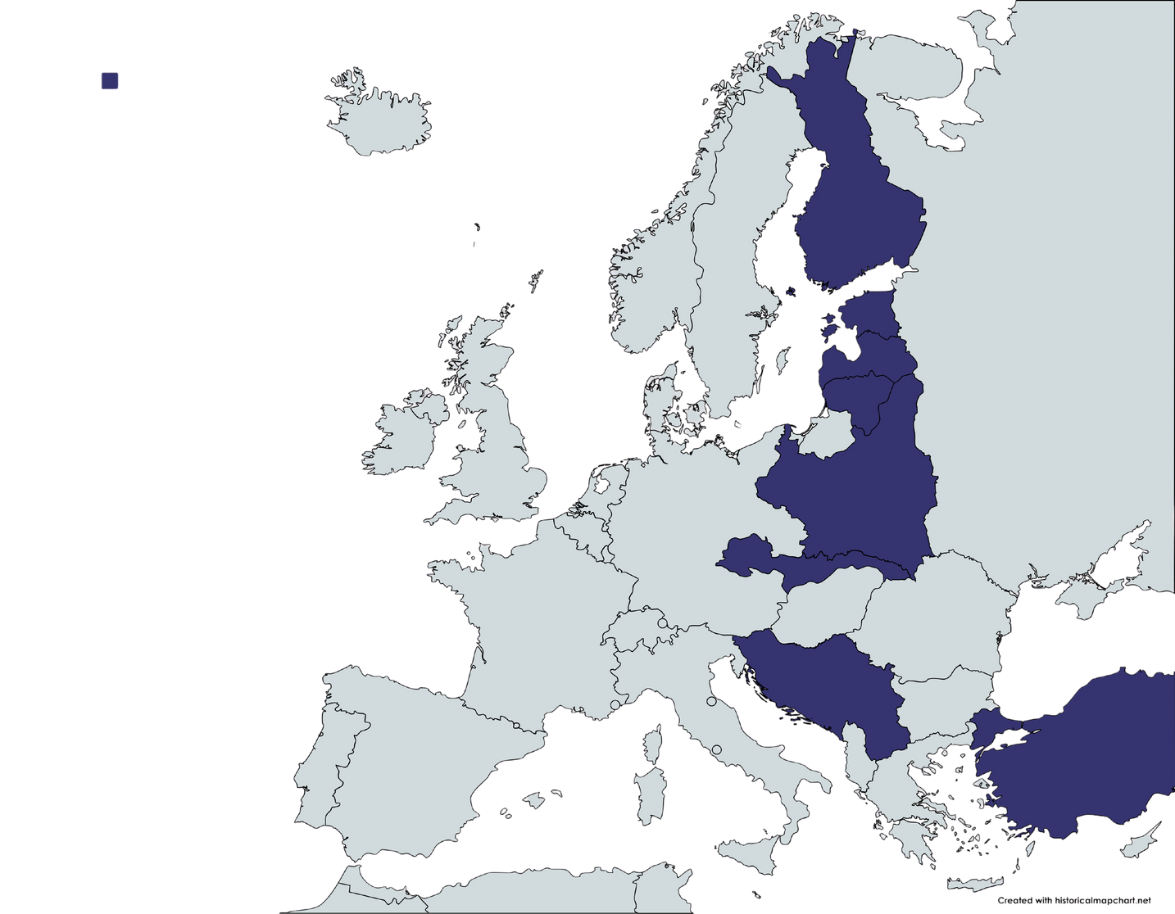
New States
The Habsburg (Austro-Hungarian) and Ottoman (Turkish) Empires were abolished, resulting in the creation of new states in Central & Eastern Europe and the Middle East. This was due to Wilson’s belief in the right to self-determination. These new states included: Poland, Czechoslovakia, Yugoslavia, Turkey, Finland, Latvia, Estonia and Lithuania.
Strand Two & Three: The History of the World
Chapter Twenty-One: World War I
@MsDoorley

Slide 26
Resentment
The treaty was deeply unpopular in Germany, where people felt it unduly harsh. They rejected the idea that they were solely responsible for the war. Along with that, they resented the humiliating loss of territory and limitations on their military. They felt betrayed by their government for signing the treaty. The political parties who signed the Treaty were attacked as the 'November Criminals'.
In Italy, there was a lot of anger that they did not receive all the land they had been promised when they entered the war. In both countries, this anger and resentment would lead to the rise in support for the new extreme nationalist ideologies of Nazism and fascism.
Strand Two & Three: The History of the World
Chapter Twenty-One: World War I
@MsDoorley

Slide 27
Economic Problems
The reparations imposed on Germany crippled its economy – and their debt would take 92 YEARS to pay off. There was mass unemployment and hyperinflation (the rapid increase in prices that made money worthless). As Germany was Europe’s largest economy, wider Europe also took a long time to recover. This ongoing economic hardship added to the bitterness felt at the end of the war.
Strand Two & Three: The History of the World
Chapter Twenty-One: World War I
@MsDoorley

Slide 28
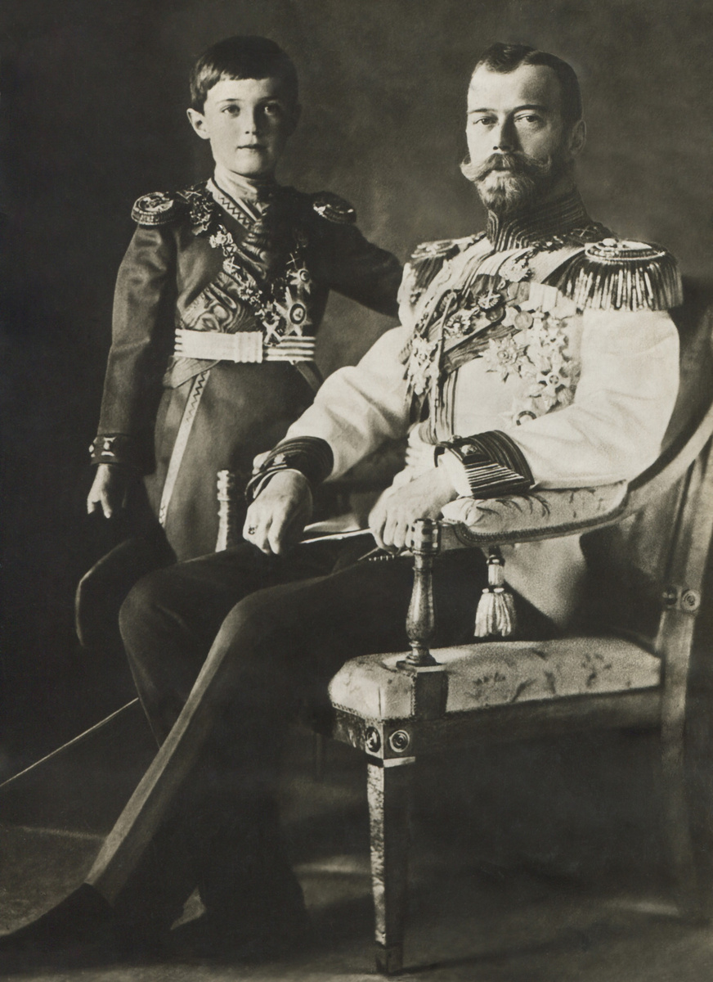
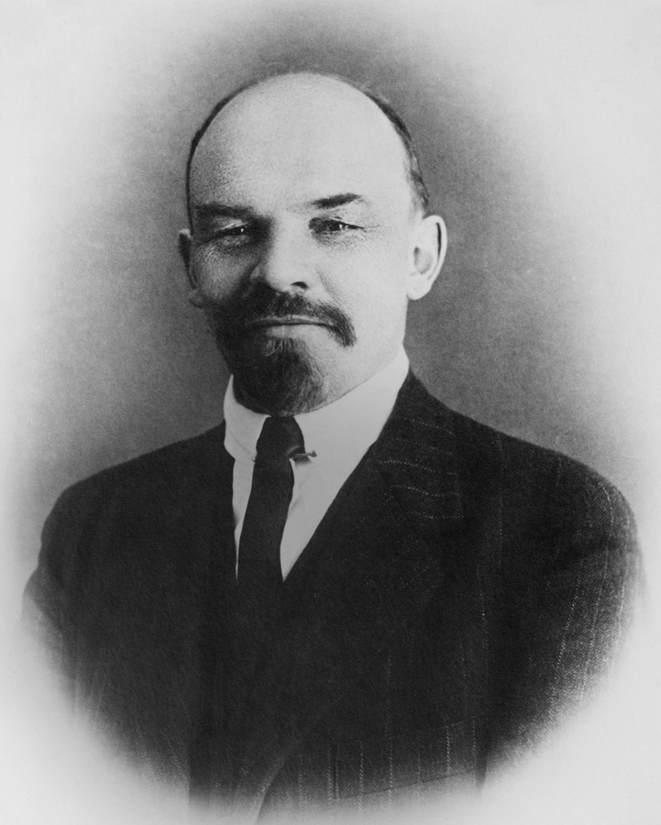
The Rise of Communism
Russia had been devasted by the war and its army’s defeat to the much smaller German army. In 1917, the Russian tsar (emperor), Nicholas II of the Romanov Dynasty, was overthrown and the world’s first communist government came to power under Vladimir Lenin. Russia would spend the next several decades trying to spread communism throughout Europe and beyond
Strand Two & Three: The History of the World
Chapter Twenty-One: World War I
@MsDoorley

Slide 29

The League of Nations
Wilson had hoped that the League of Nations would prevent future wars by settling disputes peacefully and encouraging collective security. This meant working together to stop aggression. However, the US refused to join while Russia and Germany were not allowed to join. This meant that three of the world’s most powerful states were not members, making it difficult for the League to operate with authority. This would lead to the eventual failure of the League.
Strand Two & Three: The History of the World
Chapter Twenty-One: World War I
@MsDoorley

Slide 30
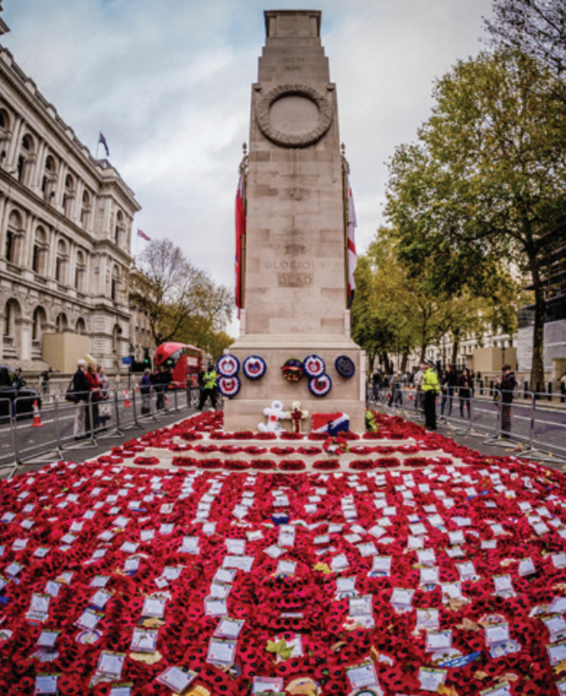





Commemorating World War I
A century after the end of World War I, it is still commemorated. Every November, people in Britain and around the world wear poppy badges to honour the soldiers who fought and died in the conflict. The badges are sold to raise money to help fund health care for wounded British soldiers of all wars. On the 11th November, the day the war ended, solemn ceremonies to remember the dead are held in countries that were involved in the fighting. Unlike events marking earlier wars, which tended to celebrate victories over the enemy, ceremonies commemorating World War I have focused on remembering the dead and honouring those who fought.
Strand One: The Nature of History
Chapter Twenty-One: World War I
Diagram taken from Artefact, 2nd Edition by Eimear Jenkinson and Gregg O'Neill (educate.ie)
@MsDoorley

Slide 31
Checkpoint pg. 291 (Artefact, 2nd Edition)
  How did World War I lead to the creation of new states? Give three examples.
  Why did the people of (a) Germany and (b) Italy resent the Treaty of Versailles?
  Where was the world’s first communist government?
  What problems did the League of Nations face?
Strand Two & Three: The History of the World
Chapter Twenty-One: World War I
@MsDoorley

Slide 32
Checkpoint pg. 291 (Artefact, 2nd Edition)
  How did World War I lead to the creation of new states? Give three examples.
    New states including Poland, Czechoslovakia, Yugoslavia, Turkey, Finland, Latvia, Estonia and Lithuania were created following the abolition of the Austro-Hungarian and Ottoman Empires, and in accordance with Wilson’s belief in the right to self-determination.
  Why did the people of (a) Germany and (b) Italy resent the Treaty of Versailles?
    The German people felt the Treaty was unduly harsh. They rejected the idea that they were solely responsible for the war and resented the humiliating loss of territory and limitations on their army.
    Italy was angered that it did not get the land it had been promisedwhen it joined the war effort.
  Where was the world’s first communist government?
    Russia
  What problems did the League of Nations face?
    Key powers such as Germany, Russia and the USA were not members, which limited the authority of the League of Nations to organise collective security and settle disputes peacefully.
Strand Two & Three: The History of the World
Chapter Twenty-One: World War I
@MsDoorley

Slide 33
1914-1918
Chapter 21
21.5: IRELAND AND WORLD WAR I
21.5: ireland and world war i
Strand Two & Three: The History of the World
@MsDoorley

Slide 34
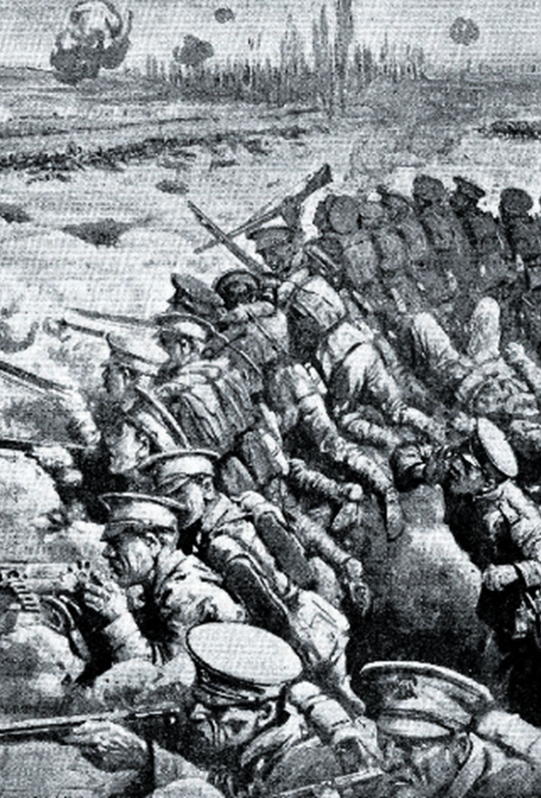
The Irish soldiers of World War I
About 250,000 Irishmen fought on Britain’s side in World War I. Between 30,000 and 50,000 died. Nationalists and Unionists fought on the same side but for different reasons. Many fought in WWI for their political beliefs but also because times were hard at home. The war was a good opportunity to earn money to send home to their families. Many, as young as 15 and 16, joined the war because they seen it as a opportunity to “become a man”.
Nationalists joined the 16th (Irish) Division which contained regiments such as the Irish Guards, the Royal Dublin Fusiliers and the Royal Munster Fusiliers. Unionist joined the 36th (Ulster) Division. The Irish soldiers fought in the Battle of the Somme in France, Passchendaele in Belgium, and Gallipoli in Turkey.
Strand Two & Three: The History of the World
Chapter Nineteen: The Rise of Nationalism and Unionism in Ireland
Diagram taken from Artefact, 2nd Edition by Eimear Jenkinson and Gregg O'Neill (educate.ie)
@MsDoorley

Slide 35
Checkpoint pg. 208 (Artefact, 2nd Edition)
  Why did (a) Unionist and (b) nationalist leaders encourage their supporters to fight in World War I?
  Why did the IVF split?
  What groups did it split into and what was the difference between them?
  How many Irishmen fought in World War I?
  Why did so many enlist to fight?
Strand Two & Three: The History of the World
Chapter Nineteen: The Rise of Nationalism and Unionism in Ireland
@MsDoorley

Slide 36
Green Fields of France - The High Kings
Well how do you do, young Willie McBride
Do you mind if I sit here down by your graveside?
And rest for a while 'neath the warm summer sun
I've been walking all day and I'm nearly done
I see by your gravestone, you were only nineteen
When you joined the great fallen in 1916.
I hope you died well and I hope you died clean
Or young Willie McBride, was it slow and obscene?
Did they beat the drum slowly, did they play the fife lowly?
Did they sound the death march as they lowered you down?
And did the band play the Last Post and Chorus?
Did the pipes play 'The Flowers of the Forest'?
Did you leave 'ere a wife or a sweetheart behind?
In some faithful heart is your memory enshrined?
Although you died back in 1916
In that faithful heart are you forever nineteen?
Or are you a stranger without even a name
Enclosed in forever, behind a glass frame?
In an old photograph, torn, battered and stained
And faded to yellow in a brown leather frame
Did they beat the drum slowly, did they play the fife lowly?
Did they sound the death march as they lowered you down?
Did the band play the Last Post and Chorus?
And did the pipes play 'The Flowers of the Forest'?
The sun, now it shines on the green fields of France
There's a warm summer breeze; it makes the red poppies dance
And look how the sun shines from under the clouds
There's no gas, no barbed wire, there's no gun firing now
But here in this graveyard, it's still no man's land
The countless white crosses stand mute in the sand
To man's blind indifference to his fellow man
To a whole generation that were butchered and damned
Did they beat the drum slowly, did they play the fife lowly?
Did they sound the death march as they lowered you down?
And did the band play the Last Post and Chorus?
Did the pipes play 'The Flowers of the Forest'?
Ah, young Willie McBride, I can't help wonder why:
Do those that lie here know, why did they die?
And did they believe when they answered the call
Did they really believe that this war would end wars?
Well, the sorrow, the suffering, the glory, the pain
The killing and dying were all done in vain
For young Willie McBride, it all happened again
And again and again and again and again
Did they beat the drum slowly, did they play the fife lowly?
Did they sound the death march as they lowered you down?
And did the band play the Last Post and Chorus?
Did the pipes play 'The Flowers of the Forest'?
Did they beat the drum slowly, did they play the fife lowly?
Did they sound the death march as they lowered you down?
Did the band play the Last Post and Chorus?
And did the pipes play 'The Flowers of the Forest'?
Strand Two & Three: The History of the World
Chapter Twenty-One: World War I
@MsDoorley

Slide 37
Working with Sources
  How old was Willie McBride when he died, and what significance might his age have in the context of World War I?
  The song frequently mentions the ceremonies and traditions (e.g., drum beats, fife playing, Last Post, and The Flowers of the Forest). What role do these traditions play in memorializing the fallen, and how do they contrast with the brutal realities of war described elsewhere in the lyrics?
  How does the songwriter depict the passage of time, especially when discussing Willie McBride's memory and the physical state of his photograph?
  Describe the imagery used to portray the present-day setting of the "green fields of France". How does this contrast with the historical setting of World War I as implied in the song?
  What significance do the "countless white crosses" have in the song, and what comment is the songwriter making about "man's blind indifference to his fellow man"?
  Based on the lyrics, how does the songwriter feel about the broader implications of war, and the repeated nature of conflict?
  "To a whole generation that were butchered and damned" – What message or sentiment is being conveyed with this line?
  The singer contemplates why soldiers like Willie McBride went to war. What reasons does he consider, and what conclusions does he draw about the overall purpose and outcome of the war?
Strand Two & Three: The History of the World
Chapter Twenty-One: World War I
@MsDoorley

Slide 38
Working with Sources (Answers)
  Willie McBride was only 19 years old when he died. His young age is significant as it underscores the tragedy of young lives lost in World War I. Many young men, some even younger than Willie, enlisted or were conscripted into the war, often with little understanding of the true horrors they would face.
  The ceremonies and traditions mentioned serve as respectful and sombre tributes to soldiers who have passed away. They offer a dignified remembrance to the fallen, celebrating their service and sacrifice. However, these rituals starkly contrast with the brutal realities of war described in the song, highlighting the difference between the sanitized or honourable depiction of war and its gruesome realities.
  The songwriter alludes to the passage of time by referencing Willie's age at death and contrasting it with the current state of his grave and memory. The old photograph, described as "torn, battered and stained and faded to yellow," serves as a poignant representation of how time has passed, yet Willie remains forever young in memory.
  The present-day imagery paints a serene and peaceful landscape with "a warm summer breeze," "red poppies dancing," and the sun shining "from under the clouds." This contrasts sharply with the implied historical setting of World War I, where there would have been gas attacks, barbed wires, and continuous gunfire. The beauty of the present setting serves as a stark juxtaposition to the devastation of the war era.
Strand Two & Three: The History of the World
Chapter Twenty-One: World War I
@MsDoorley

Slide 39
Working with Sources (Answers)
5. The "countless white crosses" symbolize the vast number of soldiers who lost their lives in the war. They serve as a haunting reminder of the human cost of conflict. The reference to "man's blind indifference to his fellow man" suggests the senseless nature of war, where life is often disregarded, and the sheer scale of loss can become numbing or abstract.
6. The songwriter expresses a profound sense of sorrow and futility about war. He questions the reasons soldiers are called to war, especially considering the painful consequences. The repeated lines "it all happened again and again and again and again" convey a sense of despair at humanity's inability to learn from past conflicts, suggesting that the tragedies of wars like World War I continue to repeat themselves.
7. This line conveys a sentiment of tragedy and condemnation. The term "butchered" implies that the generation was led to slaughter, emphasizing the senseless loss of life. "Damned" suggests a betrayal or condemnation of this generation by the forces that sent them to war, hinting at the idea that they were sacrificed for causes that may not have been just or worthy.
8. The singer wonders if soldiers like Willie McBride went to war out of a sense of duty, for love, or perhaps due to societal pressures. He questions whether they believed that their participation would end all wars. By the end, the conclusion drawn is somber, suggesting that the sacrifices, sorrows, sufferings, and even the glories of the war were all in vain since similar conflicts continued to arise in subsequent generations.
Strand Two & Three: The History of the World
Chapter Twenty-One: World War I
@MsDoorley

Slide 40
Green Fields of France - The High Kings
Written in 1976 by Eric Bogle, a Scottish-Australian songwriter. The song, also known as "No Man's Land" or "Willie McBride", is a lament about the loss and futility of war. It tells the story of a visitor who comes across a grave in a WWI cemetery in France. The grave belongs to a young soldier named Willie McBride, who died in 1916 at the age of 19. Bogle's decision to choose an Irish name, "Willie McBride", was deliberate. During the time of the song's composition, the Troubles – a violent and complex political conflict in Northern Ireland – was at its height. Anti-Irish sentiment was pervasive in parts of the UK, and Bogle wanted to remind listeners of the sacrifices the Irish had made during WWI, in an attempt to foster understanding and compassion amidst the contemporary conflict.
Through its poignant lyrics, the song contemplates the reasons Willie might have gone to war, imagining perhaps he loved a sweetheart, or was it purely for king and country. It ponders the stark contrast between the jubilant send-off young soldiers received and the tragic reality of their deaths. The chorus, which talks about the "green fields of France", alludes to the tragic irony that the once bloody battlefields of WWI, where countless young men died, have now returned to peaceful fields.
Strand Two & Three: The History of the World
Chapter Twenty-One: World War I
@MsDoorley

Slide 41
Green Fields of France - The High Kings
The song has been covered by numerous artists and has become an anthem for peace and a poignant reminder of the costs of war. It has particular resonance for the Irish, many of whom fought in WWI under British command and faced complex issues of identity and loyalty, especially during the aftermath of the Easter Rising. While not exclusively about the Irish experience in WWI, the song does resonate with the story of many Irish soldiers. Their participation in the war was for a long time a controversial and often overlooked part of Irish history, as Ireland itself was undergoing significant political change and the struggle for independence during the same period.
Strand Two & Three: The History of the World
Chapter Twenty-One: World War I
@MsDoorley

Slide 42
1914-1918
Chapter 21
20.10: SUMMARY
20.10: summary
Strand Two & Three: The History of the World
@MsDoorley

Slide 43
In this chapter, we have learned that...
  World War I broke out in August 1914. The long-term cause of the war was the rivalry between powerful European states over colonies, armaments and the Balkans. The assassination of Archduke Franz Ferdinand brought the system of European alliances into play.
  The war was mainly fought along two fronts, west and east. In the trenches of the Western Front, the opposing armies faced each other across no man’s land. Over 19 million people were killed between 1914 and 1918.
  After the war, the leaders of the victorious allies met at Versailles to negotiate a peace deal to impose on Germany.
  The Treaty of Versailles blamed Germany for starting the war, imposed significant reparations, limited the size of its military and removed some of its territory.
Strand Two & Three: The History of the World
Chapter Twenty-One: World War I
@MsDoorley

Slide 44
Reflecting on... World War I
The wars of the nineteenth century were limited to armies and battlefields - but in 1914, war became 'total'. Civilians were directly targeted by bombings and blockades. Soldiers died in their millions and many survivors were left physically and emotionally damaged. Technological advances allowed people to kill each other with far greater efficiency and detachment.
World War I changed the world: empires fell, millions died, states were created, revolutions broke out and the seeds of an even more devasting conflict were sown.
Strand Two & Three: The History of the World
Chapter Twenty-One: World War I
@MsDoorley

Slide 45
SEC Examination Questions
2023 SEC Q55
Strand Two & Three: The History of the World
Chapter Twenty-One: World War I
@MsDoorley

Slide 46
Project
Guidelines:
  Length: The depth of your project should reflect about 2-3 weeks of work.
  Sources: Use at least three different sources for your research. These can be books, scholarly articles, or reputable online resources.
  Citations: All information and images that are not your own should be properly cited.
  Mediums: You may choose to present your project in one of the following ways:
    Poster: Your poster should be informative and visually engaging.
    Minecraft or Lego Model: If choosing this option, please also include a brief report explaining your model.
    Painting/Drawing: Your artwork should be accompanied by a description.
    Recycled Materials: Create your model using recycled materials and provide an explanation of your creative process.
Assessment:
Your projects will be assessed based on:
  Research and Content
  Creativity and Presentation
  Understanding of Context
  Adherence to Guidelines
Strand Two & Three: The History of the World
Chapter Twenty-One: World War I
@MsDoorley

Slide 47
Project
Historical Sites
Historical Figures
Somme Battlefields, France
Ypres, Belgium
Gallipoli Peninsula, Turkey
Verdun, France
War Memorial Gardens, Islandbridge, Dublin
Prince Max von Baden
Kaiser Wilhelm II
Winston Churchill
Constantine I
Sir Christoper Cradock
Archduke Franz Ferdinand
Emperor Josef I
Paul von Hindenberg
Tsar Nicholas II
Erich Ludendorff
John J. Pershing
Gavrilo Princip
Maximilian von Prittwitz
Radomir Putnik
Paul von Rennenkampf
Alexander Samsonov
Wilhelm Souchon
Sir Charles Townshend
King George V
Queen Victoria
Woodrow Wilson
Strand Two & Three: The History of the World
Chapter Twenty-One: World War I
@MsDoorley

